Slide 1


Parallel and Distributed Systems / 8
Pavel Krömer, Dept. of Computer Science, VSB – Technical University of Ostrava

Slide 2
Covered topics
Topics so far:
Parallel platforms and environments
Distributed environments
Standard interfaces and tools
This talk
Parallel algorithm design
Task/Channel model
Foster’s design methodology

Slide 3
Parallel Algorithm Design

Slide 4
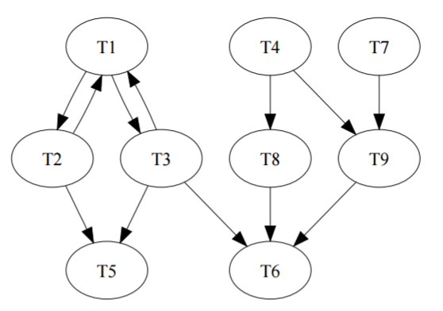
Task/Channel model
Parallel program modelled as a collection of tasks that communicate by sending messages through channels
Task is an executable unit (local memory, I/O ports for non-local data access)
Channel is message queue (maintains order of messages, no dupla, no lost)
Read operation (from a channel) blocks, but sending does not
Lifetime is time between start of first task and end of last task

Slide 5
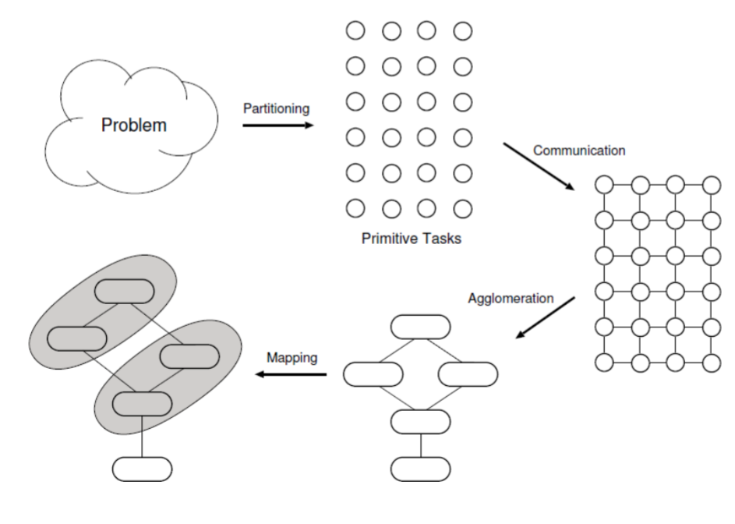
Foster’s design methodology
A logical methodology for parallel program design
Ian Foster: Designing and Building Parallel Programs: Concepts and Tools for Parallel Software Engineering, Addison-Wesley Longman Publishing Co., Inc. Boston, MA, USA, 1995, ISBN:0201575949
4 stages
Partitioning
Divide computation and data to pieces
Communication
Determine how tasks will communicate, local and global patterns
Agglomeration
Group tasks into larger (tasks) to improve performance (simplify coding)
Mapping
Assign tasks to physical resources (processors, cores)

Slide 6
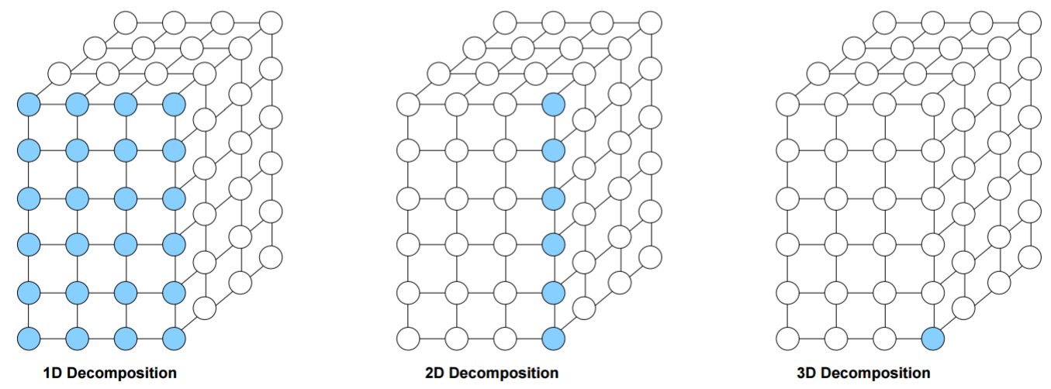
Foster’s design methodology: Partitioning
Goal
Discover as much parallelism as possible. Other stages of FDM aim at reducing parallelism
Methods
Domain decomposition
Split data into pieces to which parallel actions (primitive tasks) can be applied
Find the largest and most frequently accessed data artifact and break it into many small (equally sized) pieces
Problem decomposed by data

Slide 7
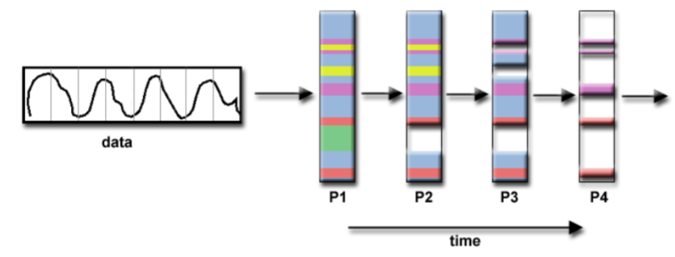
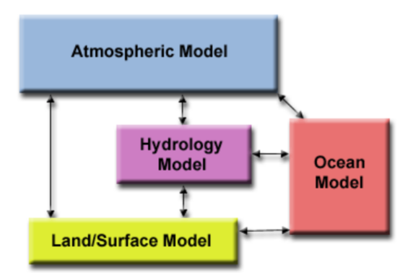
Foster’s design methodology: Partitioning (II)
Functional decomposition
Different operations applied concurrently to different parts of data
Primitive tasks mapped to these operations
For problems without inherent data parallelism
Problem decomposed by work
2 ways this can end
Computational pipeline (in different processes)
vs
Independent tasks

Slide 8

Foster’s design methodology: Partitioning (III)
Partition should provide at least an order of magnitude more tasks than processors in target system
Redundancy (in computation and storage) should be avoided (compare: map-reduce, GPU computing)
Primitive tasks should have similar size to enable efficient allocation to processors (and similar runtime)
The number of tasks should increases with problem size (no size of tasks)
Try to identify alternative partitionings, check domain and functional decomposition

Slide 9
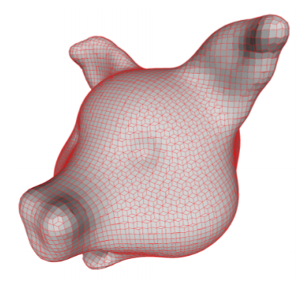
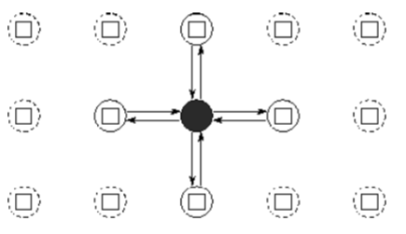
FDM: Communication
Define information flow between tasks
Local communication
Between small number of tasks
Global communication
Many tasks need to exchange data
Structured communication vs Unstructured communication

Slide 10
FDM: Communication (II)
All tasks should perform similar amount of communication ops. Otherwise, it will scale poorly
Each task should communicate with small number of neighbours
Communication ops. should be able to run in parallel
Tasks should perform as much computations as possible in concurrent

Slide 11

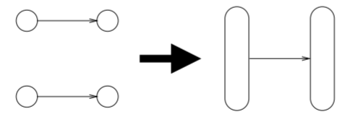
FDM: Agglomeration
Re-consider partitioning and communication by combining tasks to reduce overhead and improve performance
Combines (groups of) small tasks to create larger tasks
In fact a multi-objective optimization problems with conflicting tasks
It usually tackles
Granularity
Increase locality by merging tasks with channel inbetween
Combine groups of tasks that all send and all receive from each other
Must not prevent scalability (and portability) and SW engineering aspects (code re-use etc.)

Slide 12
FDM: Agglomeration (II)
Reduce communication by increasing locality
Redundancy in computation should be paid for by benefits (e.g. scalability)
Data replication should not restrict the result and compromise scalability
Agglomerated tasks should be similar in size of communication and computation
The number of tasks still scales well with problem size
It still fits current and future target platforms
Number of tasks cannot be made any smaller without imbalance or scalability problems

Slide 13
FDM: Mapping
Assigns a processor to each task
Goal
Minimize total execution time, maximize processor utilization (for all procs.)
Approach
Place tasks that run concurrently on different processors
Place tasks that communicate frequently on the same processor
Methods
Regular communication: even, cyclic, interleaved assignment
Irregular communication:
Static load balancing (communication known beforehand, decisions at compile (launch)-time)
Dynamic load balancing (analysis of running tasks)
Task scheduling (good for independent tasks)

Slide 14
FDM: Mapping (II)
Consider single task/processor or multiple tasks/processor assignment
Decide between static and dynamic allocation of tasks to procs.
If a centralized controller is used, make sure that it will not become a bottleneck
Choose a suitable algorithm for dynamic load balancing (if used)

Slide 15
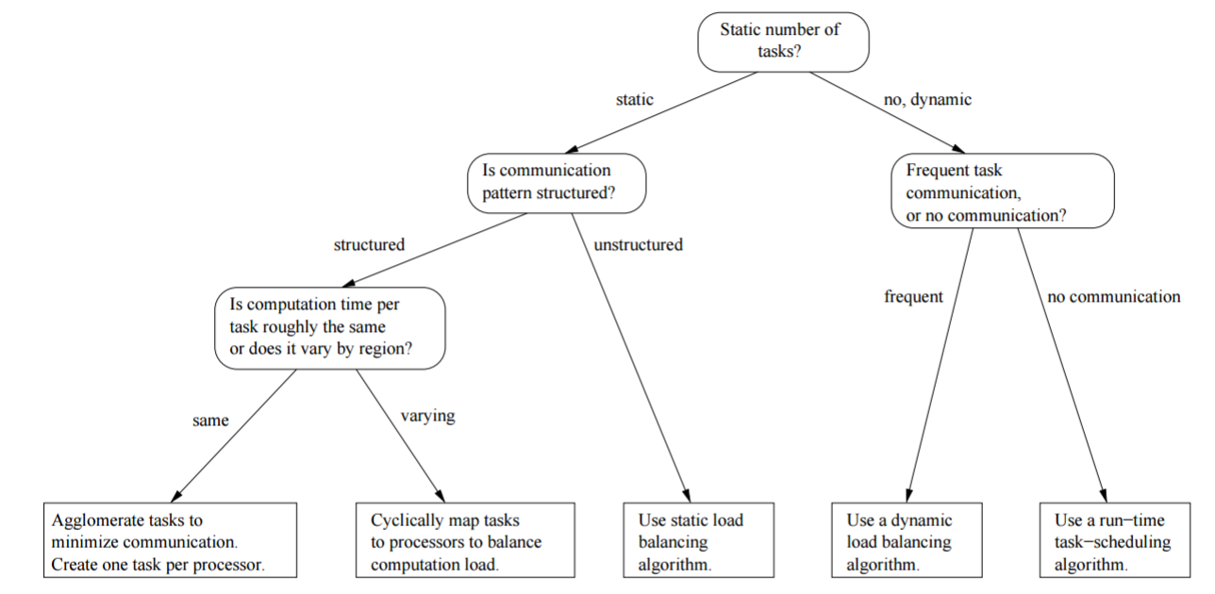
FDM: Mapping (III)

Slide 16
Parallel programming patterns

Slide 17
Patterns
Quality description of problem and solution to a frequently occurring problem in some domain.
(object oriented programming, network apps…)
Description usually involves problem definition, driving forces, solution, benefits, difficulties, related patterns, antipatterns
Pattern Language
a collection of design patterns, guiding the users through the decision process in building a system.
Wait, not again …

Slide 18
Patterns?
But origin (and use) way beyond the scope of Computer Science
Alexander, Christopher (1977). A Pattern Language: Towns, Buildings, Construction. Oxford University Press, USA. p. 1216. ISBN 0-19-501919-9.
Patterns for city planning, landscaping, and architecture, an attempt to capture the principles of a “living” design

Slide 19
Patterns !

Slide 20
Parallel Programming Patterns
Parallel software does not fully exploit parallel hardware
Too difficult for programmers
Parallel Programming Environments do not focus on design issues (sic!)
Need a “cookbook” that will guide the programmers systematically to achieve peak parallel performance
(decomposition, algorithm, program structure, programming environment, optimizations)
Provide common vocabulary to the programming community
Software reusability & modularity

Slide 21
Patterns for Parallel Programming
Mattson, Sanders, Massingill: Patterns for Parallel Programming (2005)
4 design spaces
Algorithm Expression
Finding Concurrency
Expose concurrent tasks
Algorithm Structure
Map tasks to processes to exploit parallel architecture
Software Construction
Supporting Structures
Code and data structuring patterns
Implementation Mechanisms
Low level mechanisms used to write parallel programs
In fact an analogy to Fosters methodology

Slide 22
Finding Concurrency
Task decomposition
Function calls
Independent loop iterations
Data decomposition
Often related to task decomposition
Start with this when
The algorithm is woven around a large data structure
Similar operations are applied to different parts of the data structure
Pipeline decomposition

Slide 23
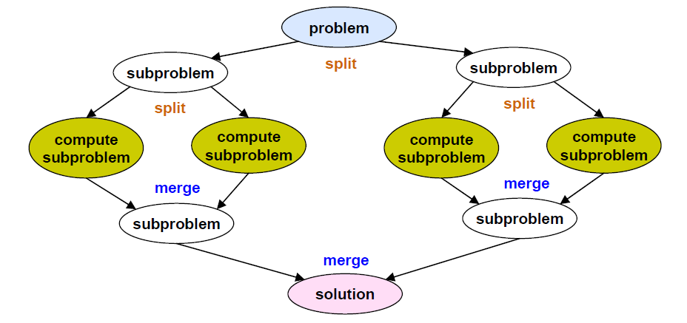
Common Types of Data Decomposition
Array-like data structures
Decomposition of arrays along rows, columns, blocks
Recursive data structures
Example: decomposition of trees into sub-trees

Slide 24
Common Parallel Patterns
Embarrassingly Parallel
Replicable
Repository
Divide & Conquer
Pipeline
Recursive Data
Geometric
Irregular Mesh
Inseparable

Slide 25
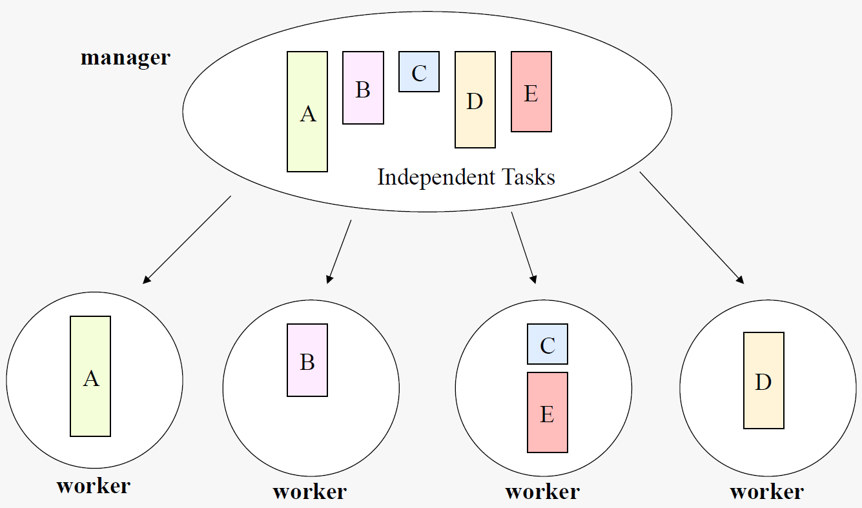
Embarrassingly Parallel
For problems composed of Independent Tasks

Slide 26
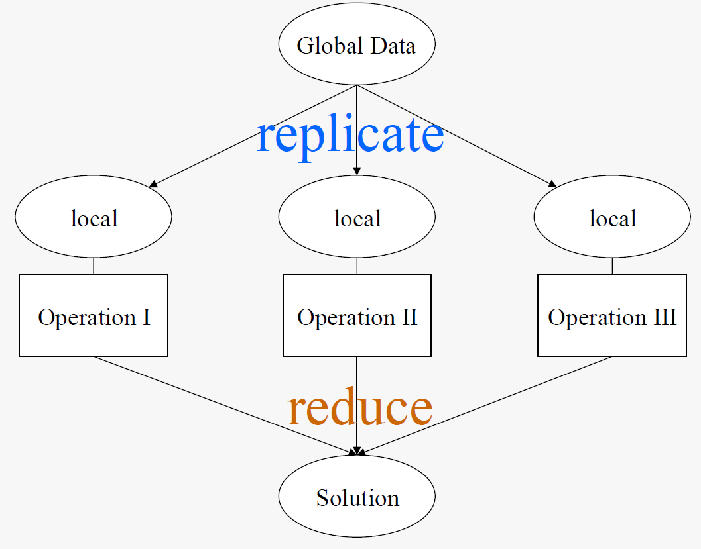
Replicable
Sets of operations need to be performed using global data structure, causing dependency

Slide 27
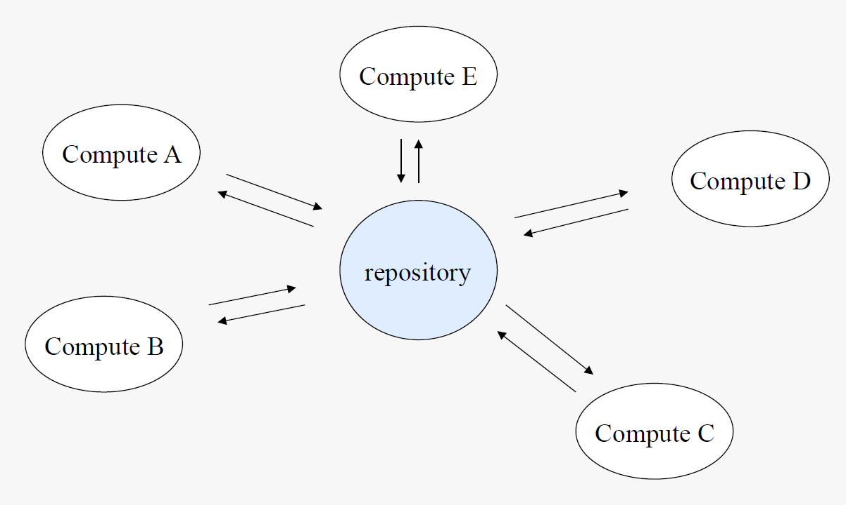
Repository
Independent operations applied to a centralized data structure in a non-deterministic way
Access is managed by a repository (tasks cannot access single element simultaneously)
Function calls often asynchronous

Slide 28
Divide & Conquer
Problem decomposed into independent sub-problems, solutions merged

Slide 29
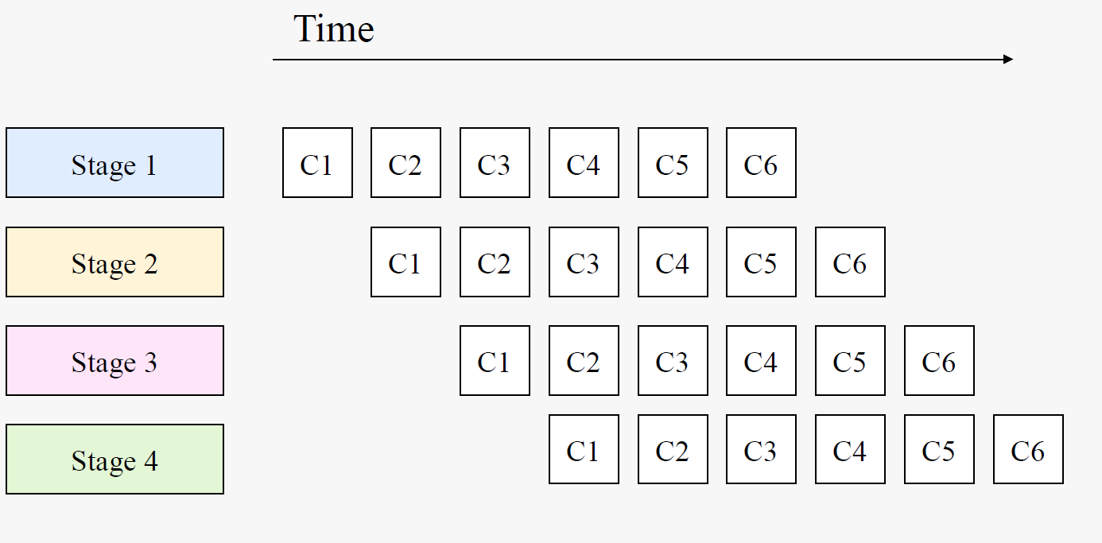
Pipeline
A series of ordered but independent computation stages need to be applied on data, where each output of a computation becomes input of subsequent computation

Slide 30
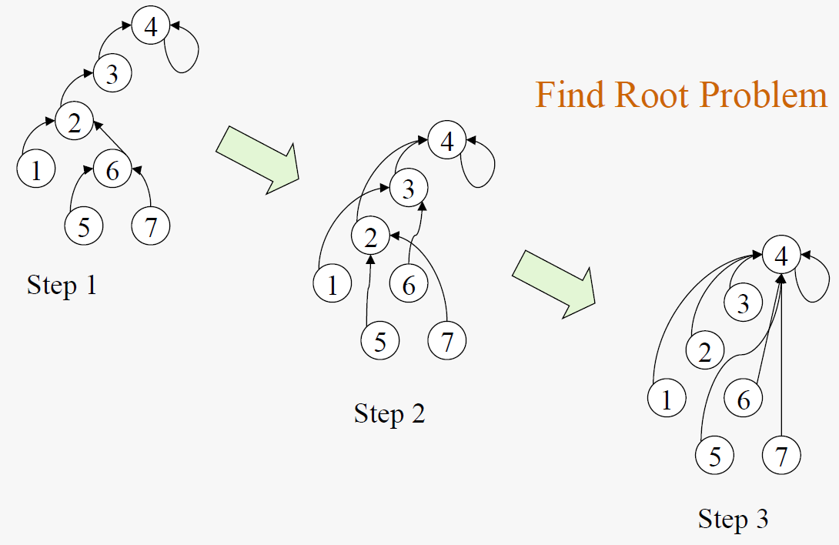
Recursive Data
Little space for concurrency in the original form, but sometimes can be transformed into a more suitable form

Slide 31
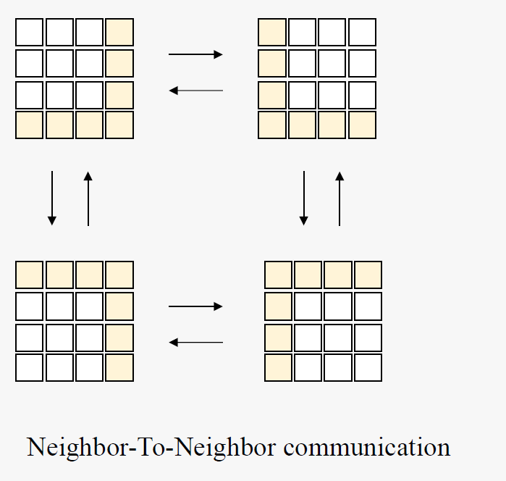
Geometric
Dependencies exist, but communicate in predictable (geometric) neighbor-to-neighbor paths

Slide 32
Irregular Mesh
Communication on non-predictable paths in a mesh topology. Look at patterns (and principles) that constructed the mesh, statistical analysis

Slide 33
Inseparable
When all reasonable patterns fail
Explicit protection when processing dependent elements
Mutual exclusion, producer-consumer
Very vague definition

